Slide 1

Revenge of the Worms: Rethinking Non-linear Mixed Effect Models
Statistical Rethinking Book Club
Gina
October 14 2020

Slide 2
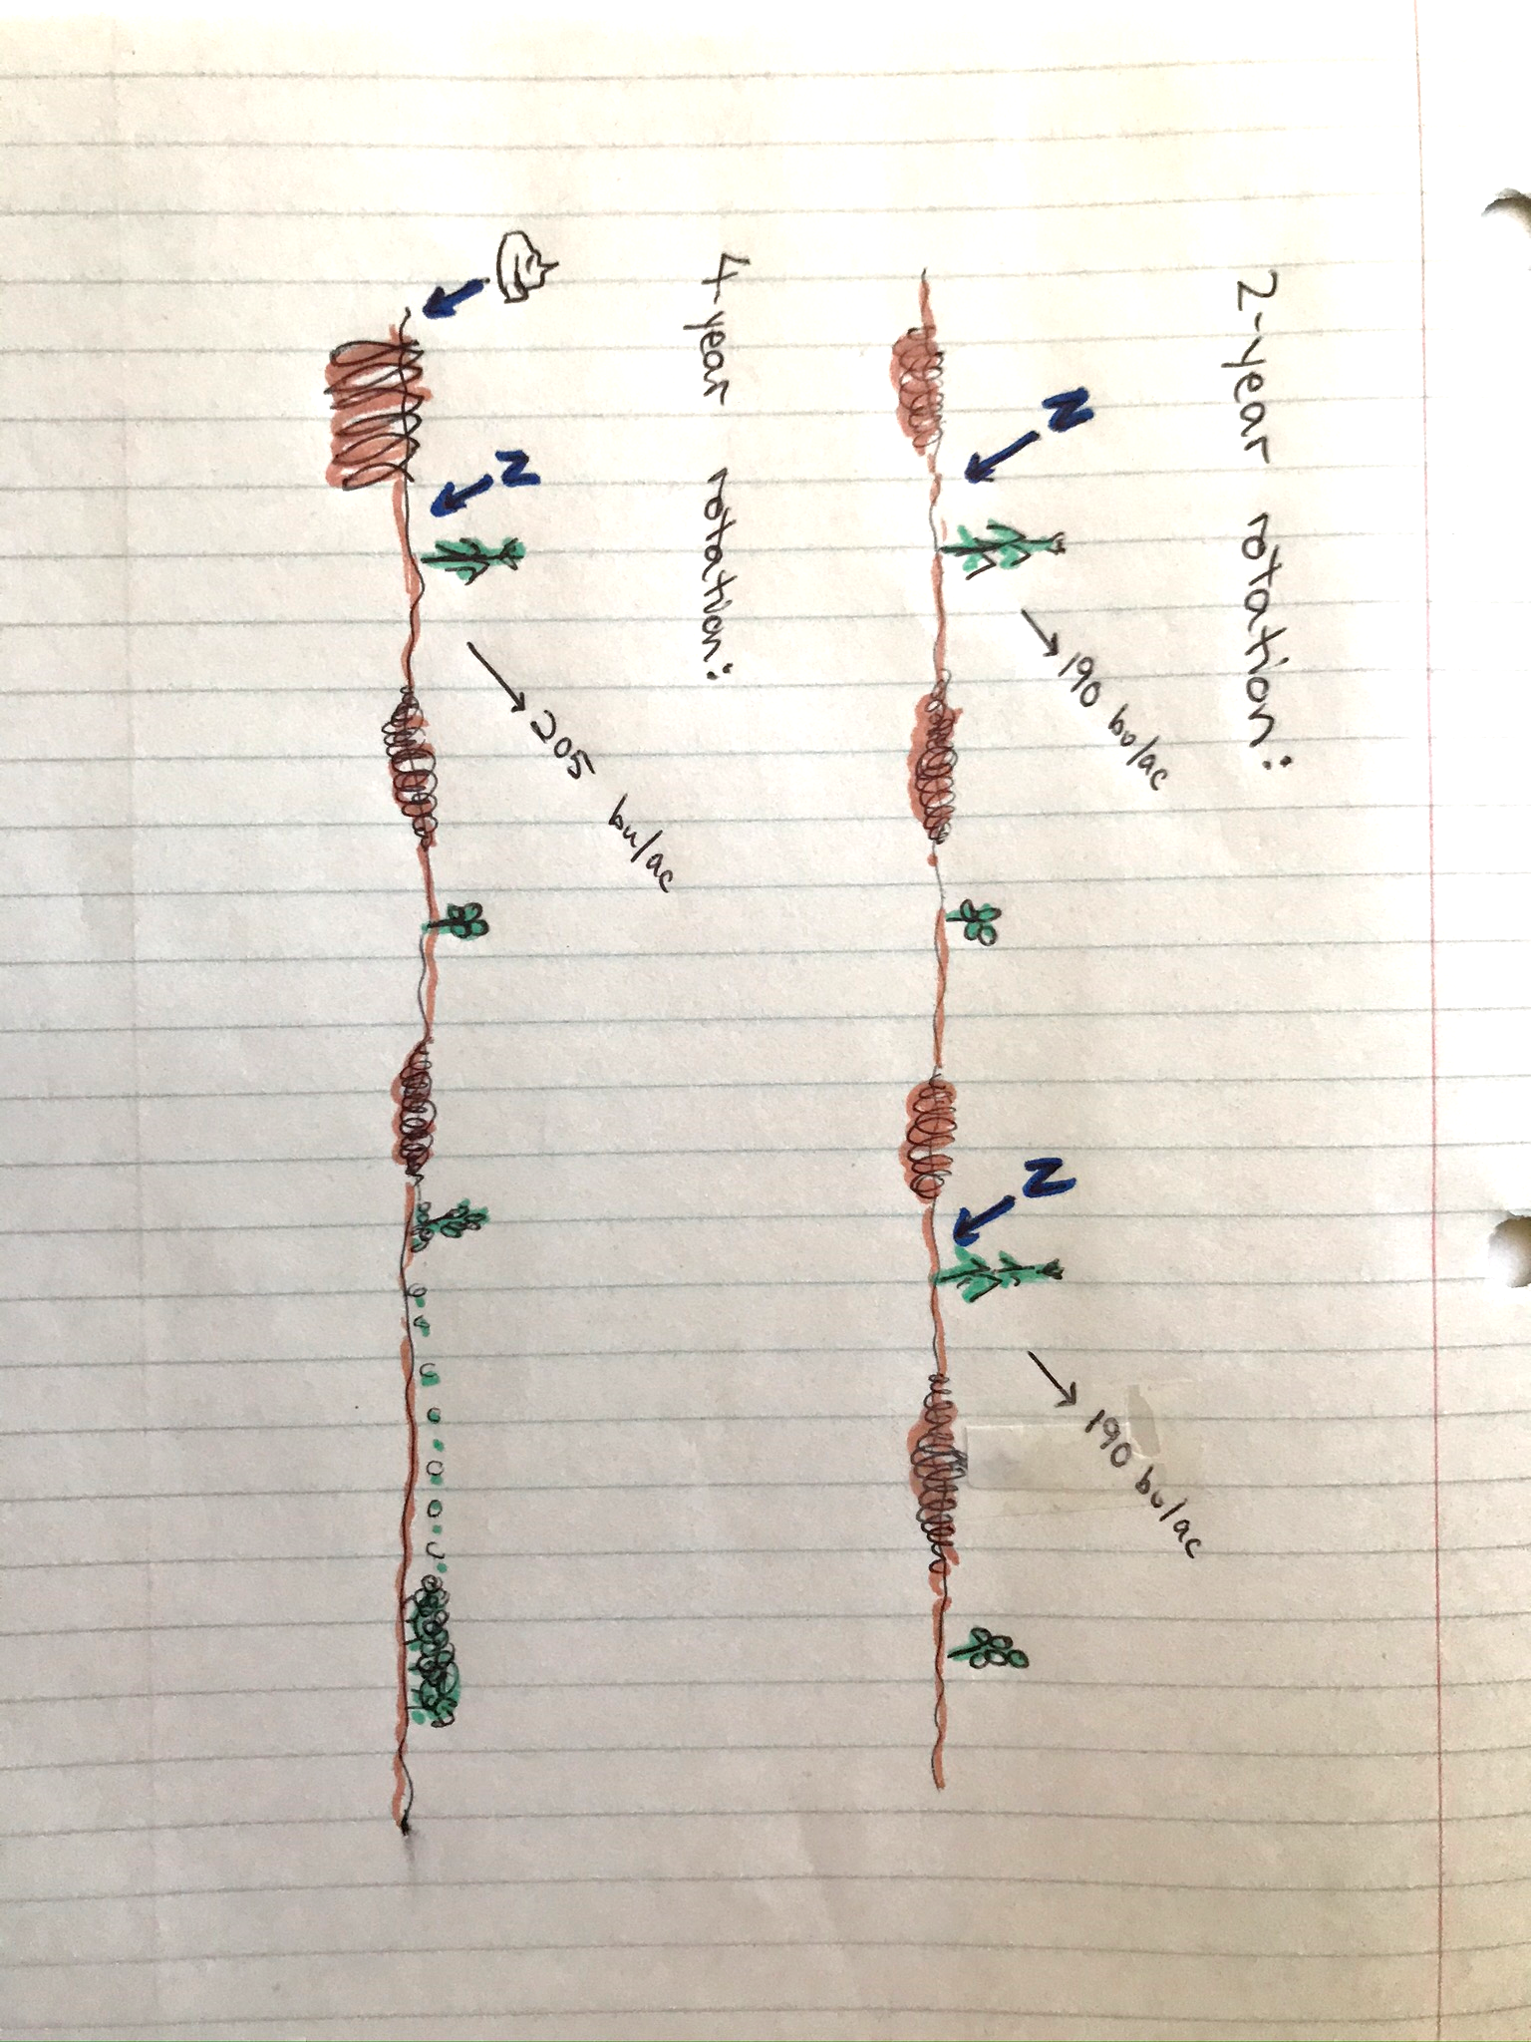

Slide 3
Rethinking!
Corn Yields
Cropping system history
?

Slide 4
Rethinking!
Corn Yields
Cropping system history
?
Tillage
Disease
Nutrient distribution
Root channels
A kazillion other things

Slide 5
Rethinking!
Corn Yields
Cropping system history
?
Tillage
Disease
Corn Roots
Nutrient distribution
Root channels
A kazillion other things

Slide 6
Rethinking!
Corn Yields
Cropping system history
?
Tillage
Disease
Corn Roots
Nutrient distribution
Root channels
A kazillion other things

Slide 7
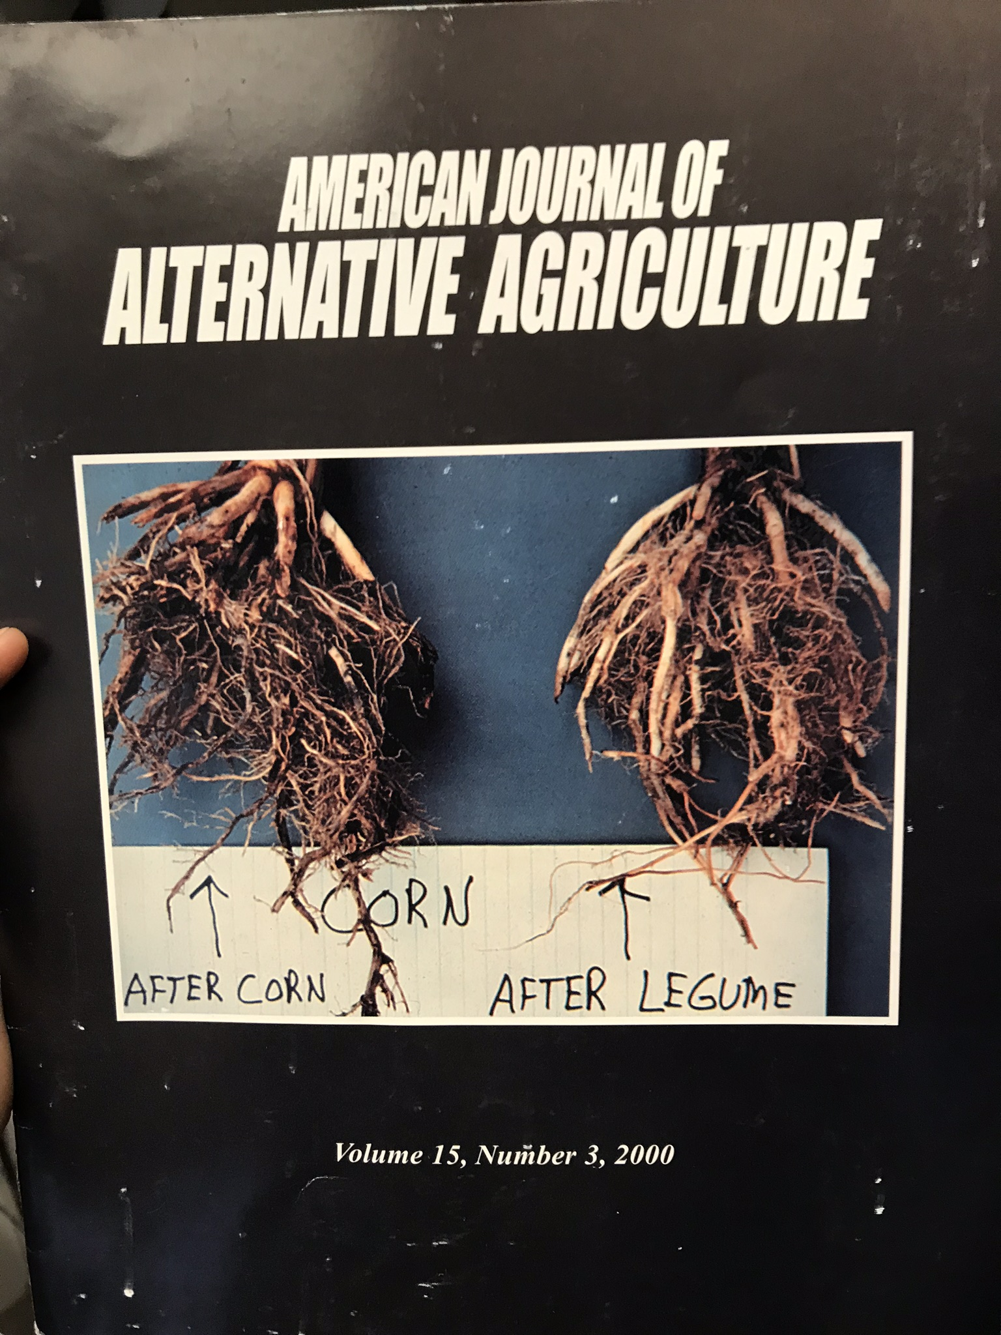
Cropping system history
?
Corn Roots
Tillage
Disease
Nutrient distribution
Root channels
A kazillion other things

Slide 8
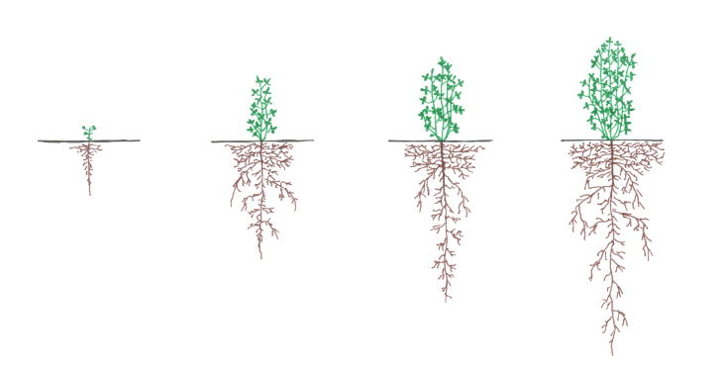
Maximum Root Depth
0
10
20
30
40
50
Days After Planting

Slide 9
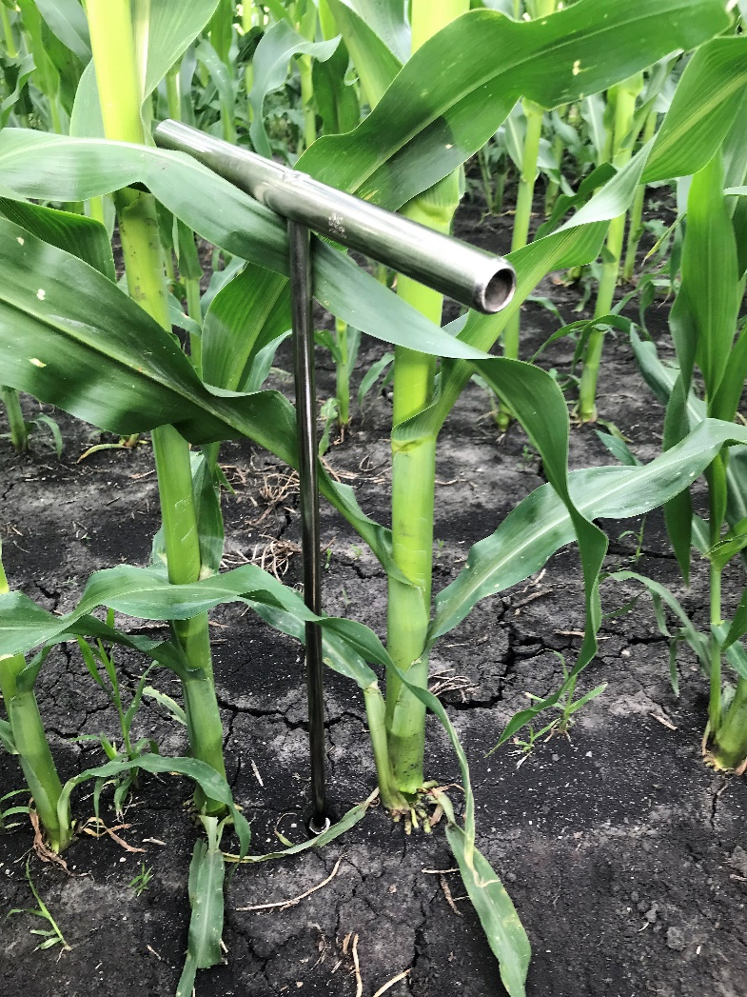
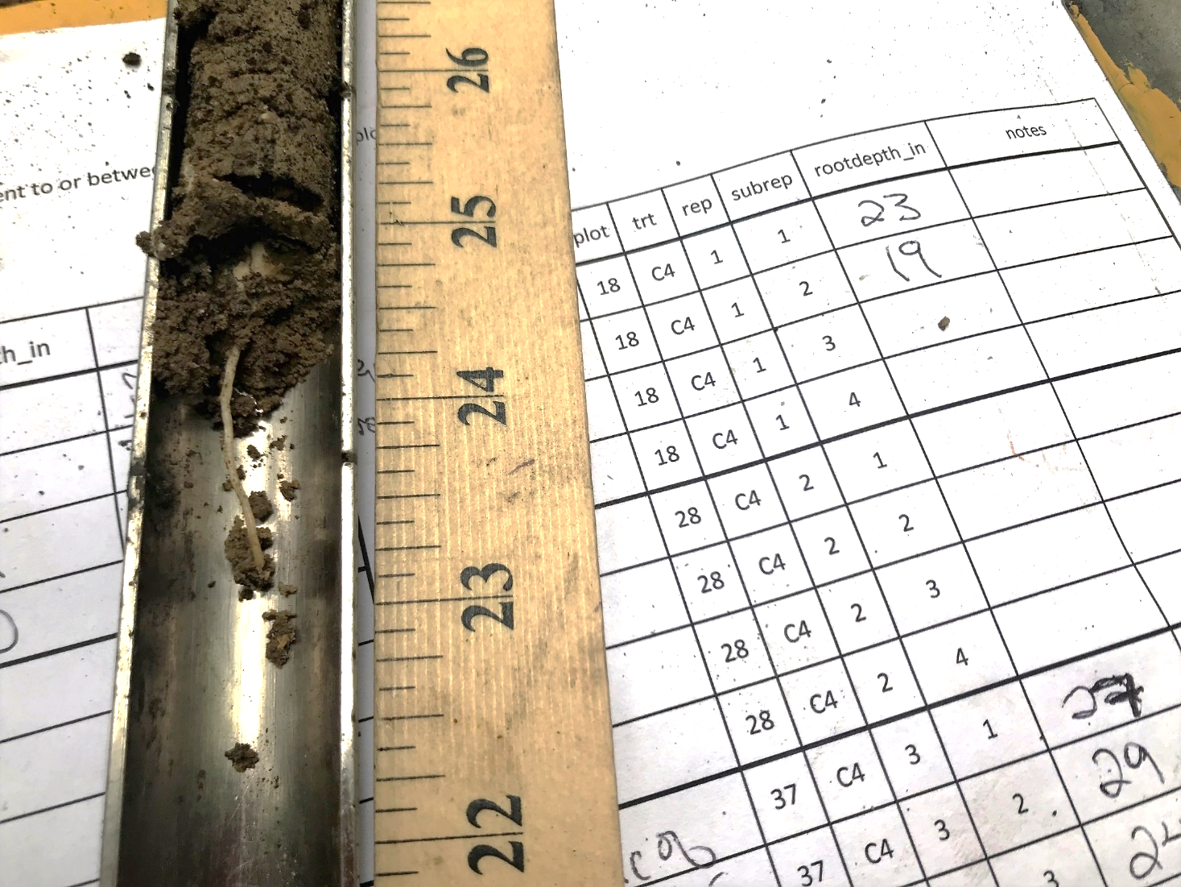
Maximum Root Depth
0
10
20
30
40
50
Days After Planting

Slide 10
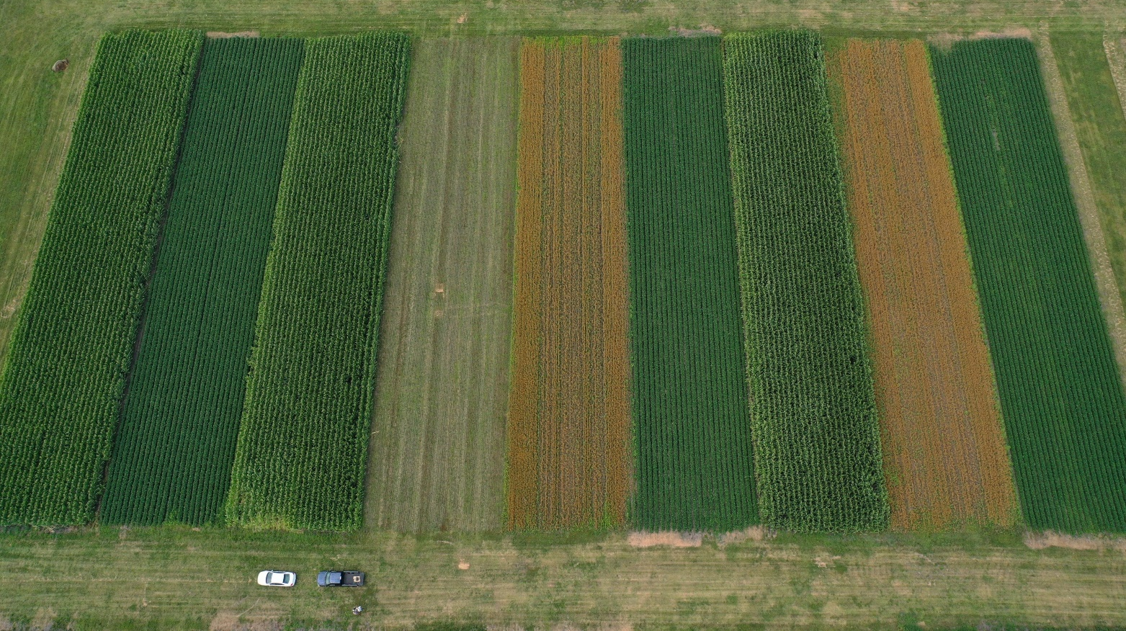
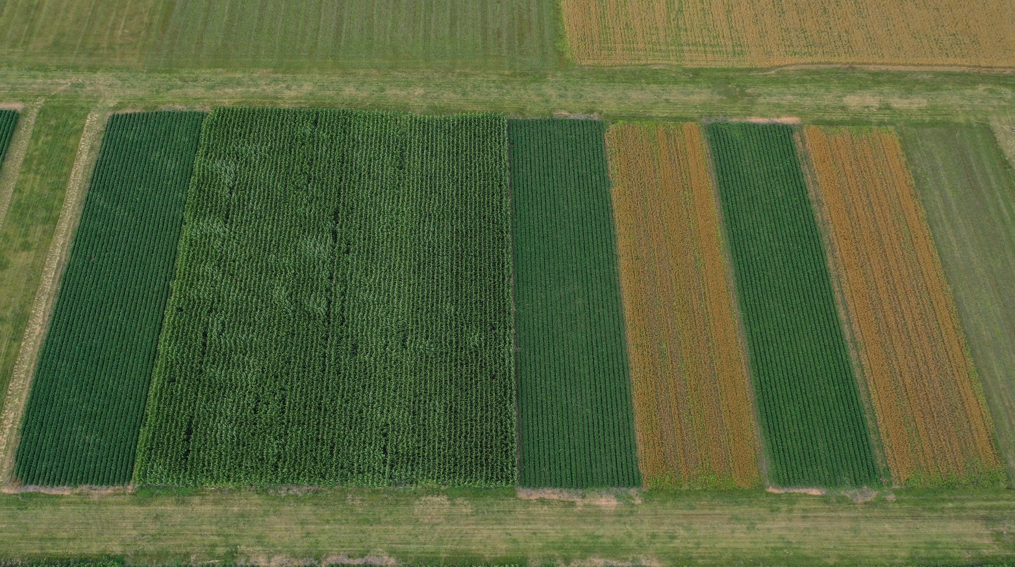
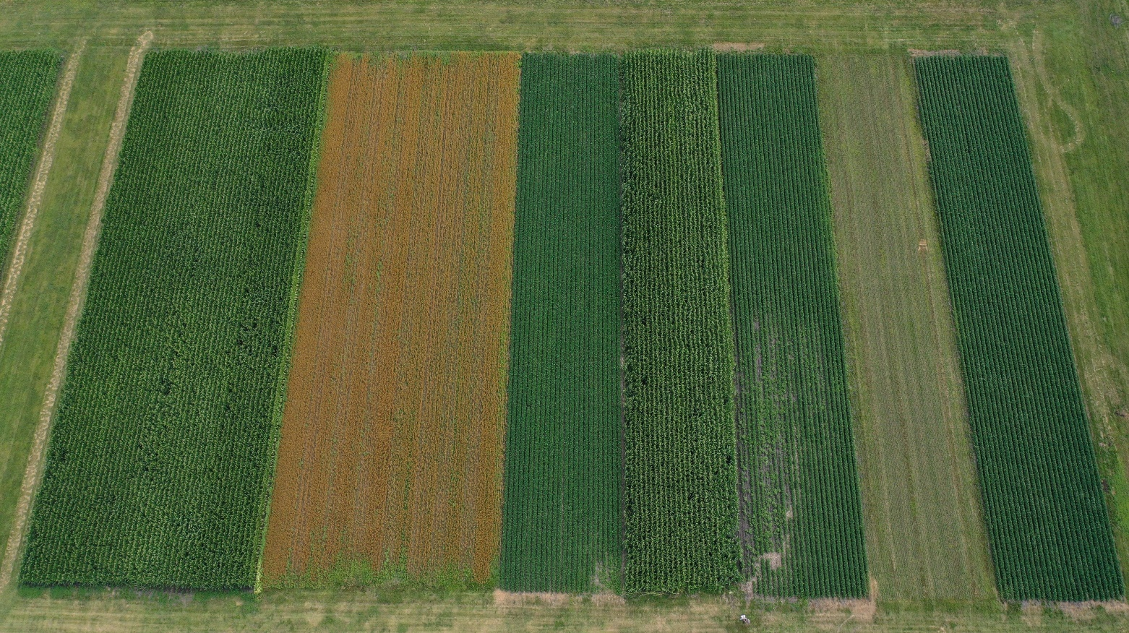
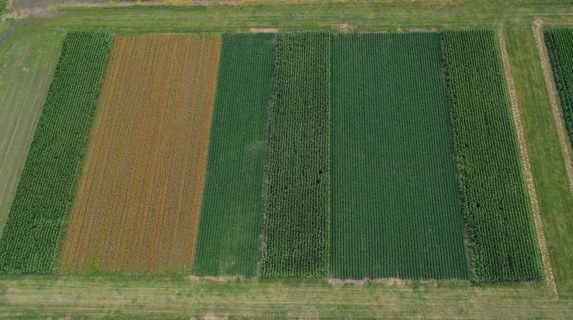

Slide 11
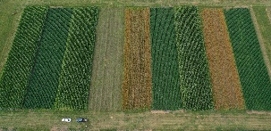
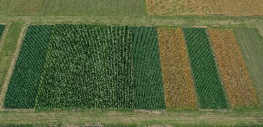
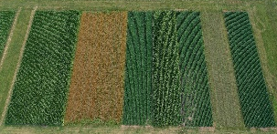
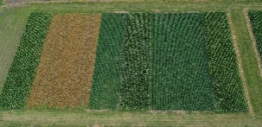
June 1
June 15
May 1
…

Slide 12
June 1
June 15
May 1
…
June 1
June 15
May 1
…
June 1
June 15
May 1
…

Slide 13
Rethinking!
Simple Rotation
Diverse Rotation
2018
2019
2020

Slide 14
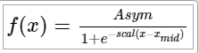
Simple Rotation
Diverse Rotation
2018
2019
2020

Slide 15
Simple Rotation
Diverse Rotation
2018
2019
2020

Slide 16
Asym_{i} ~ Normal (μ_{i,} σ)
μ_{i} = μ_{overall} + Xβ_{rot} + α_{year} + γ_{plot}
μ_{overall} ~ Normal (80, 30) (the distribution of Asym for the simple rotation treatment)
β_{j} ~ Normal (0, 15) for j = 1 (“fixed” effect of diverse rotation treatment)
α_{j} ~ Normal (α, σ_{α}) for j = 1, 2, 3 (year effect comes from a distribution with a mean of α)
α ~ Normal(0, 1.5) (the mean of the year effect distribution is normally distributed)
σ_{α} ~Exponential(1) (the sd of the year effect distribution has this distribution)
γ_{j} ~ Normal (γ, σ_{γ}) for j = 1..24 (plot effect comes from a distribution with a mean of γ)
γ ~ Normal(0, 1.5)
σ_{γ}~Exponential(1)
σ ~ Exponential(1)

Slide 18
Let’s use the frequentist results to guide us.
Do we need to let Asym, scal, and xmid vary by year and plot?
Do we need to model the variance?

Slide 19
Frequentist lessons:
Asym and xmid probably vary by rotation treatment
Most of the variation for all of the parameters is in the year, plot explains very little
The variation gets larger as time goes on

Slide 20
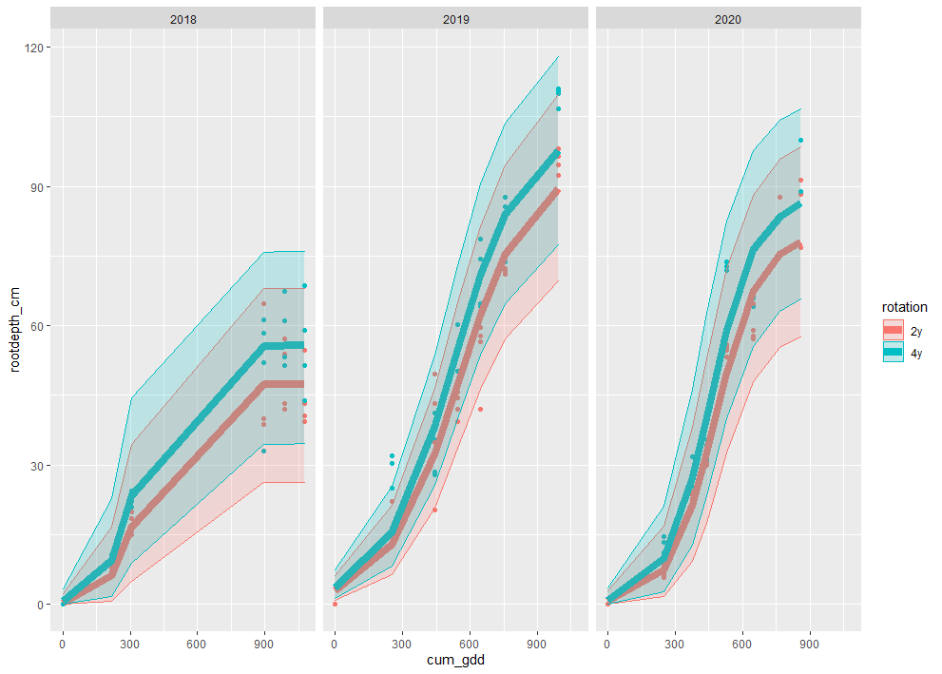
Courtesy of Fernando’s nlraa package.
In the diverse rotation, the corn’s maximum rooting depth is 5.5-11.5 cm deeper than in the simple rotation. So about 5 inches if we are feeling generous.

Slide 21
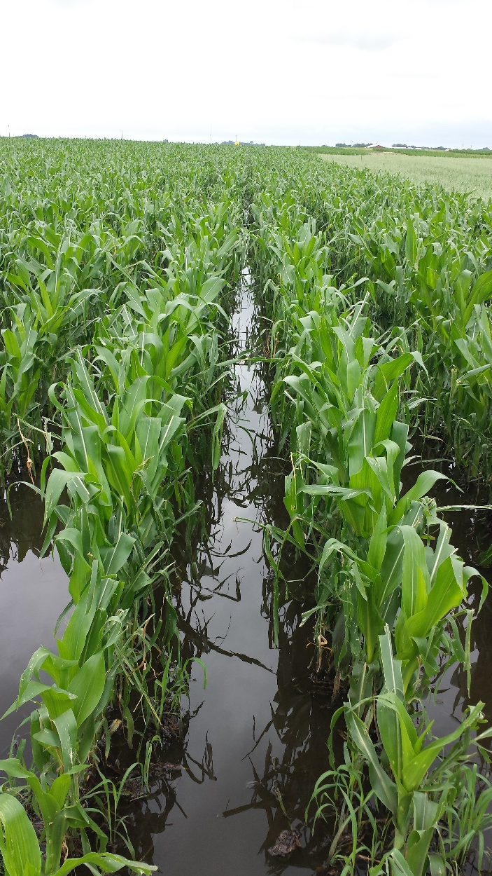
Courtesy of Fernando’s nlraa package.
In the diverse rotation, the corn’s maximum rooting depth is 5.5-11.5 cm deeper than in the simple rotation. So about 5 inches if we are feeling generous.

Slide 22
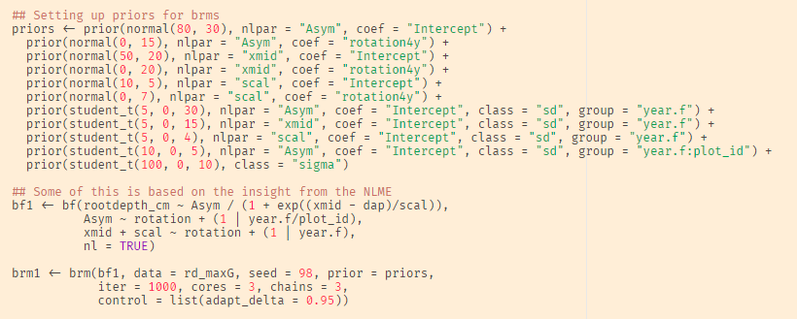
Translate into brms?
Kind of. I updated to R 4.0 and can’t get brms to run. But Fernando wrote me some code that should work.

Slide 23
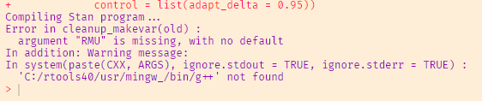
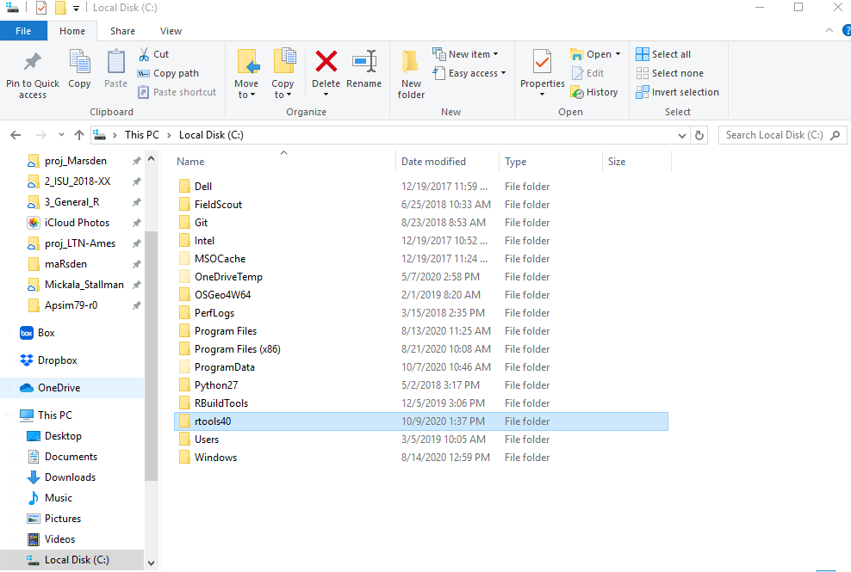
Anyone else have this problem?

Slide 24
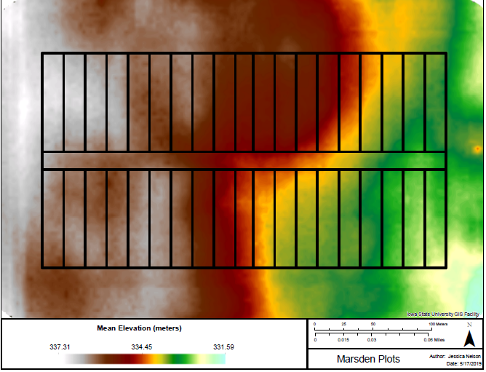
Improvements?

Slide 25
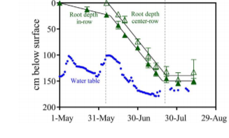

Slide 26

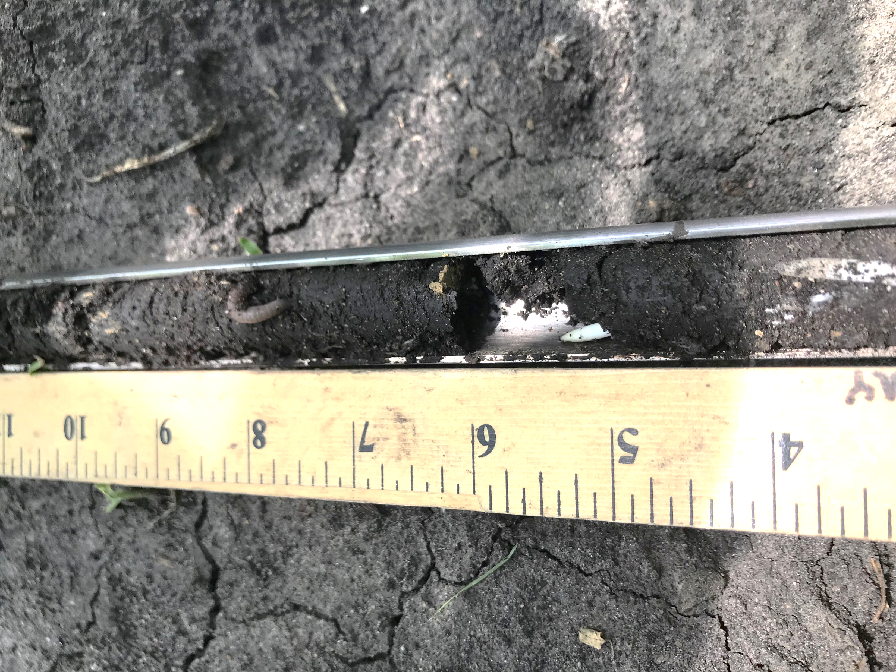
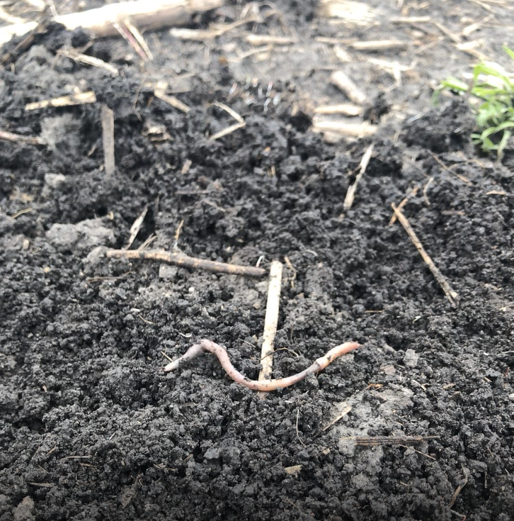
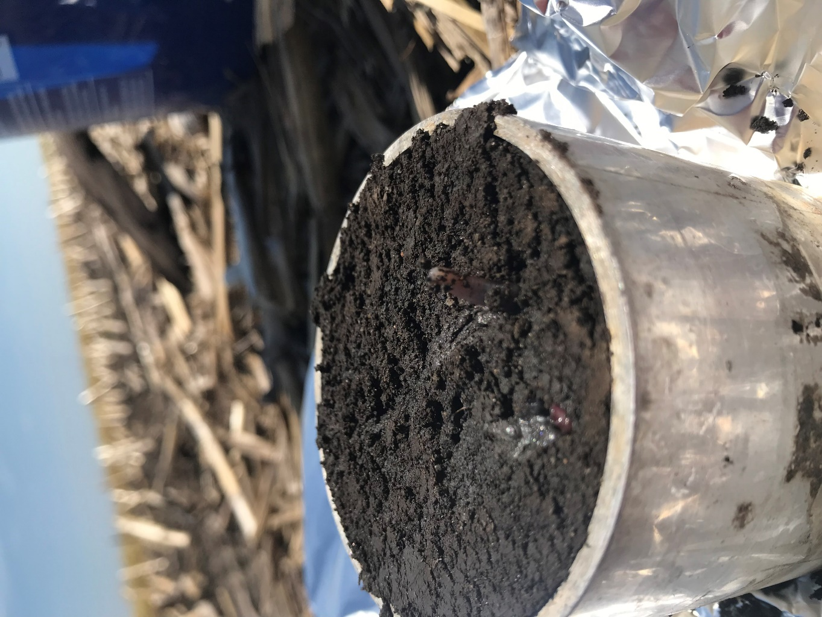
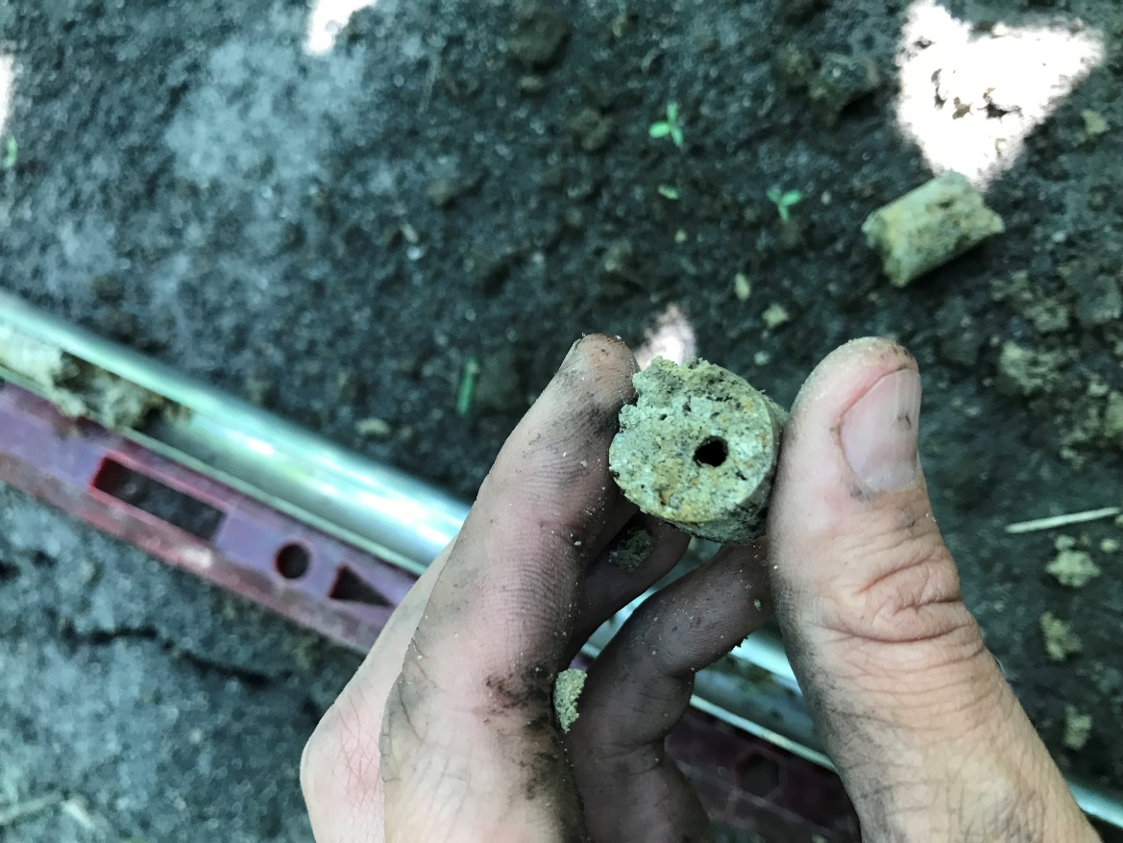
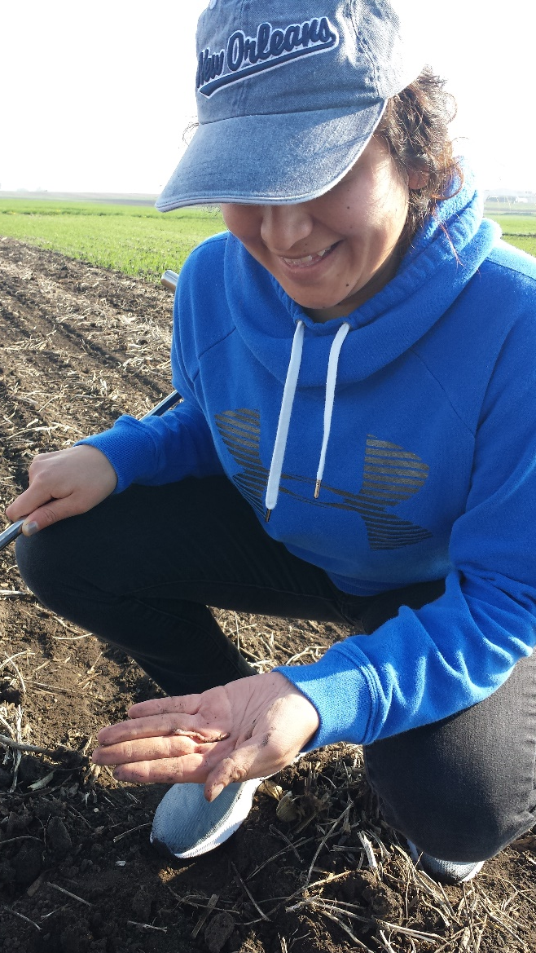
worms

